Slide 1
Tour & Hospitality Management System with AI based Virtual Assistant

Slide 2
Introduction
Our system is an end to end complete software solution which will help the tourists.
Problem Statement :
Traveler can not stay in local house and can not take virtual guideline
Solution:
Local Host
Virtual Assistant

Slide 3
Literature Review
450
400
3,23,000
Revenue (million dollar)
Bangladesh had
Recorded Traveler in 2019
350
Traveller
62.39% percentage increase in 2022
3 out of 5
0
Travel Interested people
2018
2019
2020
2021
2022
Year

Slide 4
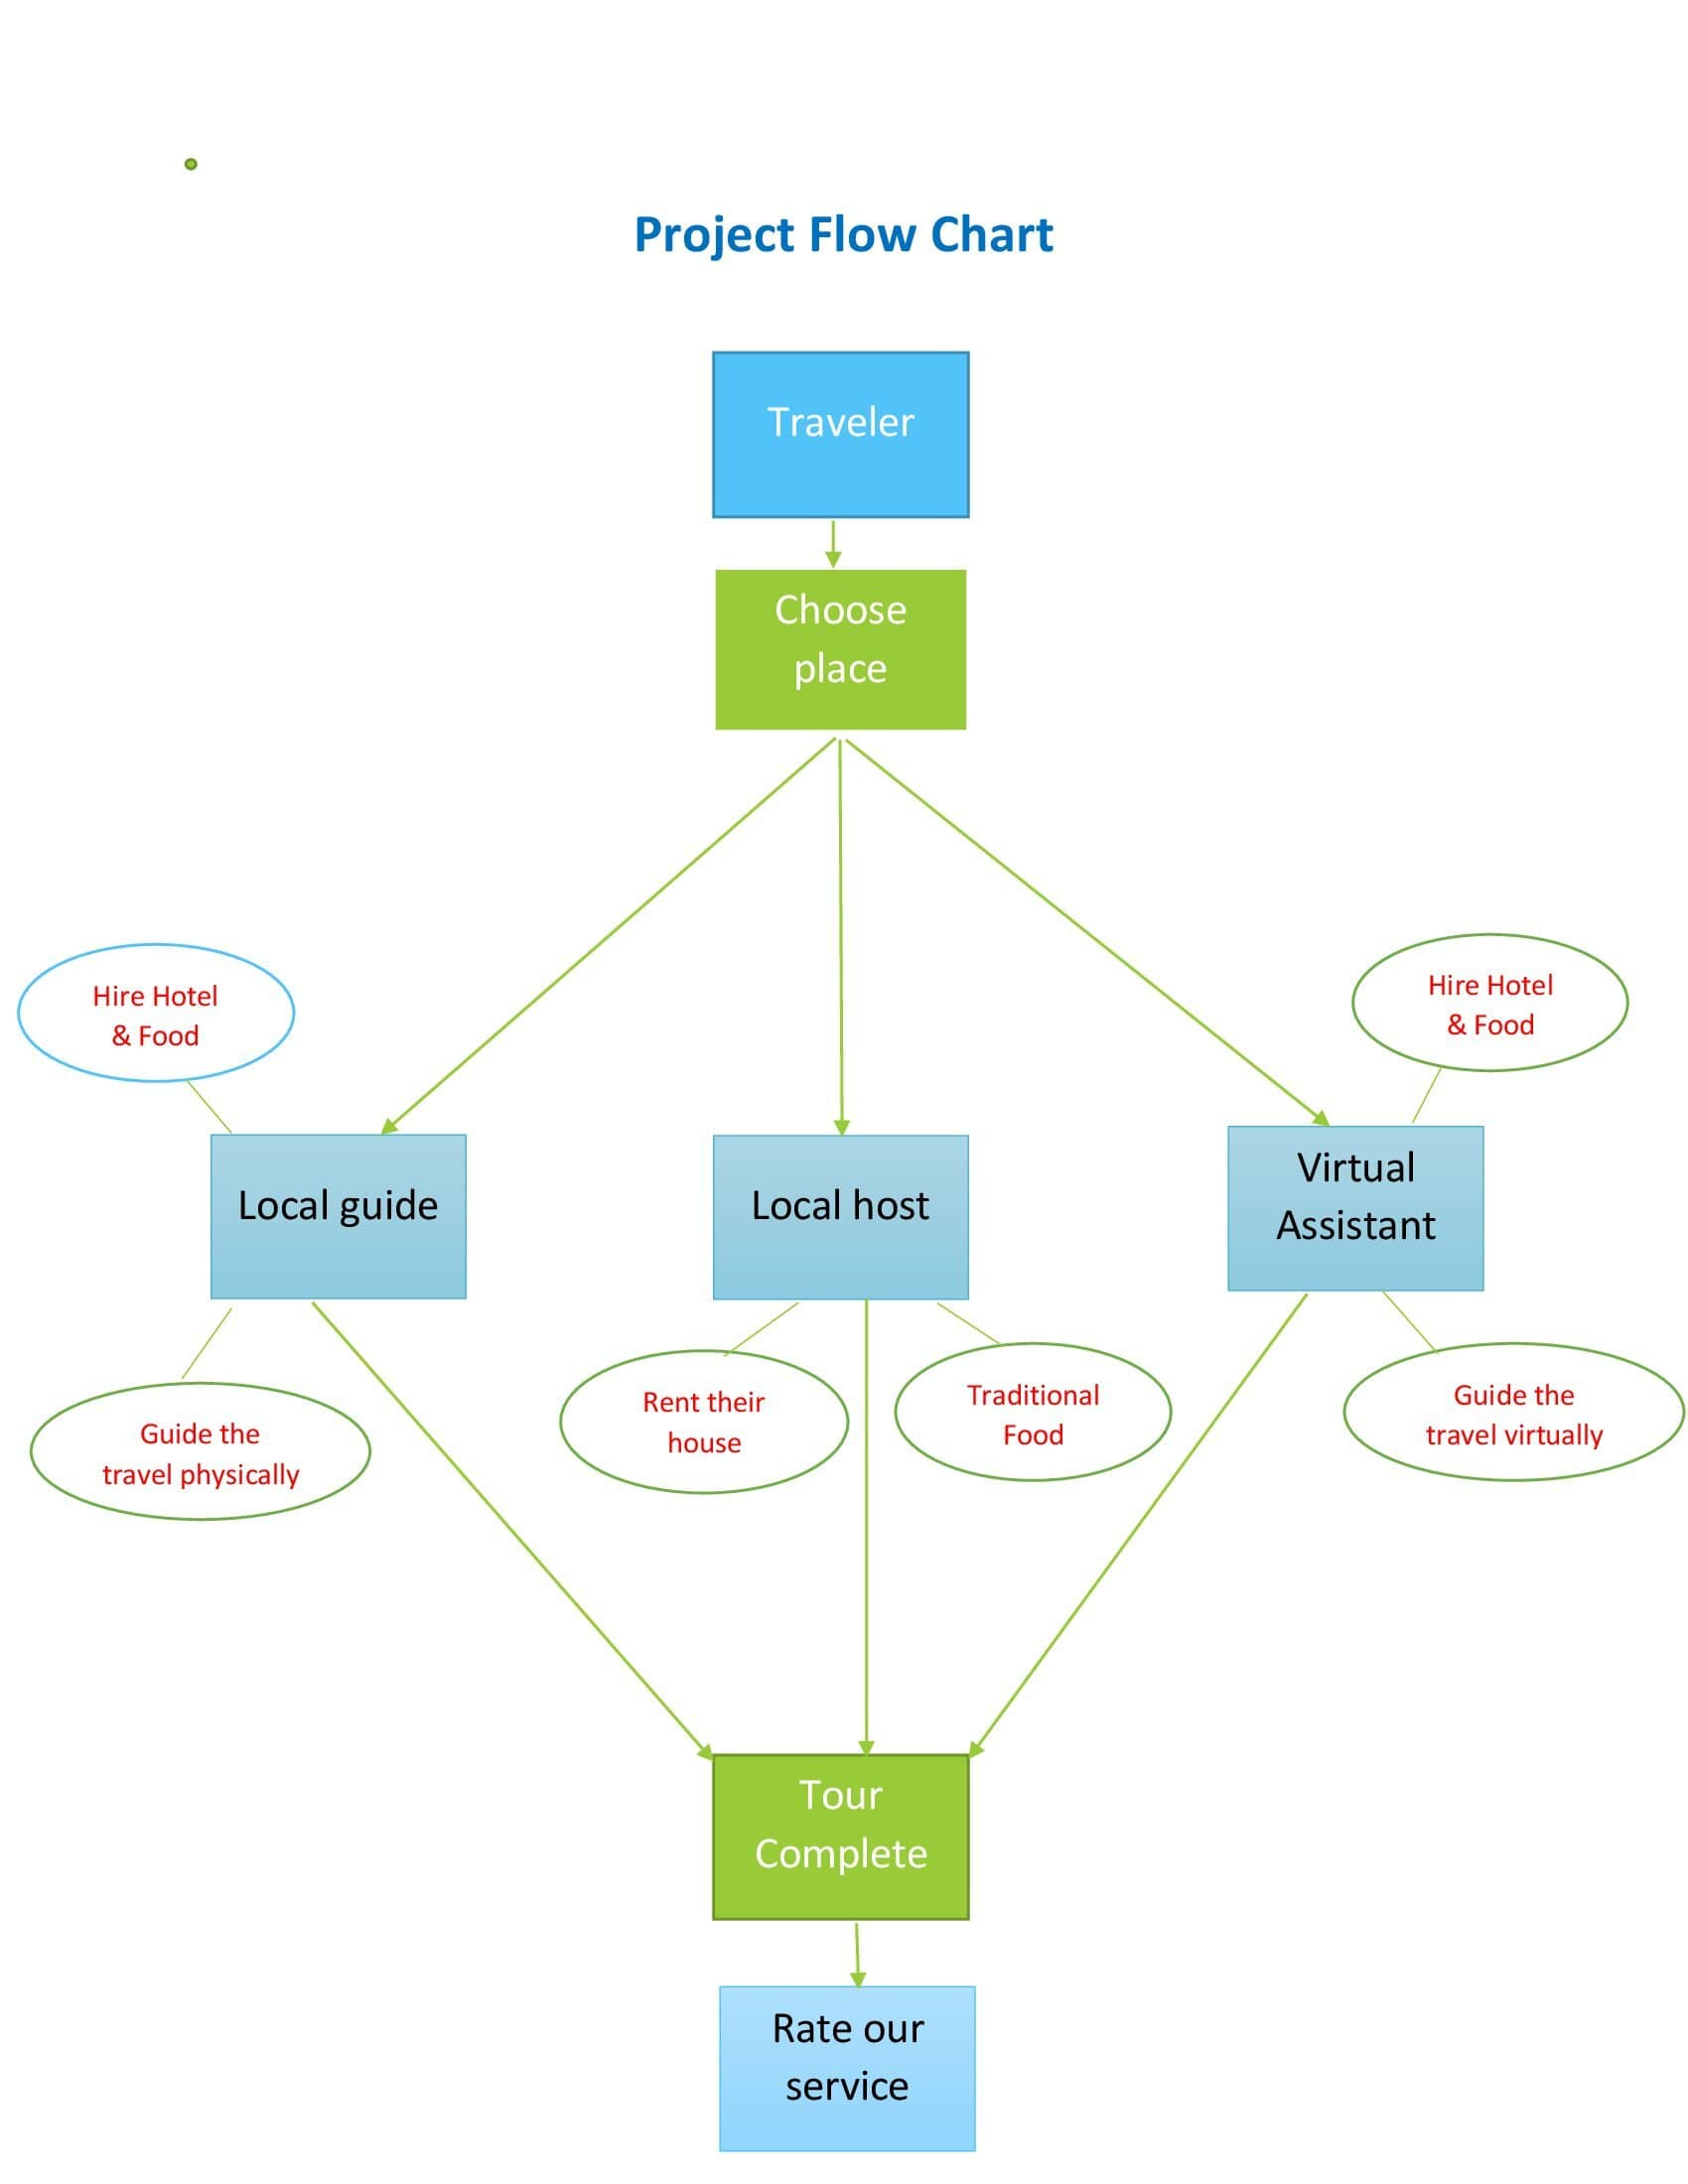

Slide 5

Local Guide
Hiring Hotel and Restaurant based on tourist’s budget and demand
Guide the tourist physically
Hire local guide based on tourist budget and guide’s rating

Slide 6

Local Host
Stay in local house
Tour in low cost
Know about local langage
Take an Advanture feel

Slide 7

Virtual Assistant
Find out tourist location
Find out any distance from tourist
Translate language
Find out today’s news

Slide 8
Why our system is better than manual and existing system ?
Providing virtual assistant
Get benefit of staying in regional house
Opportunity to travel alone at tourists own time
Select best guide and host based on rating and tourist’s budget
Local guide & host earn money independently

Slide 9
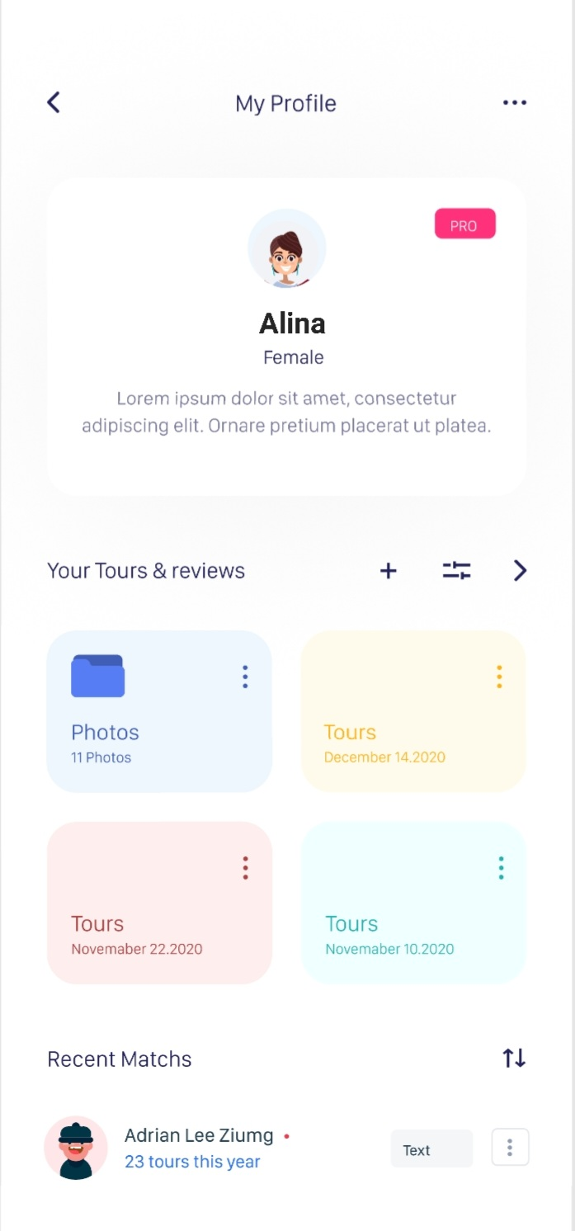
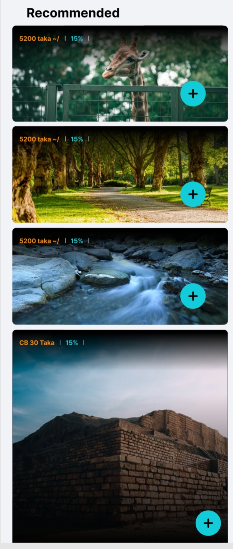
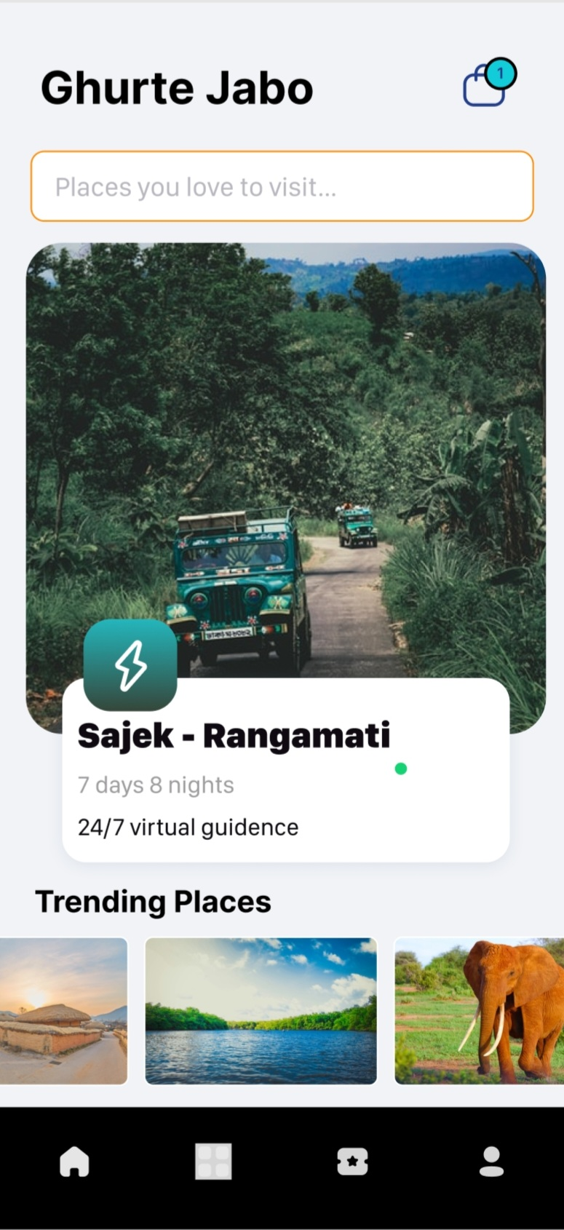
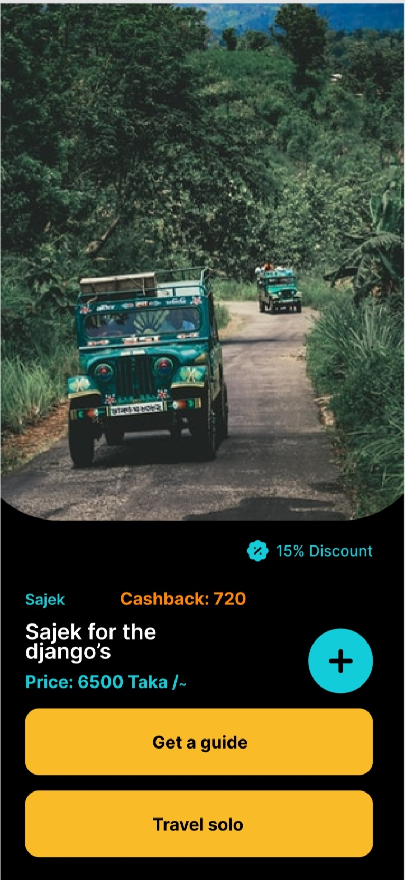
Mockup Design

Slide 10





Laravel Framework
Which technology will be used in this project?
For backend Web development
React js/Vue js/ Laravel Blade Template
For Frontend For Web design
React Native/Flutter/Java/Kotlin
For App development
Artificial Intelligence
For Virtual Assistant

Slide 11



Role of Team Members and their information
Sajeeb Chakraborty
Backend Web & Apps Developer
AI Developer
Roll : 1811076104
MD AL Amin
Jahid Hasan
Frontend Web Designer
AI Developer
Roll:1811176133
Frontend App Designer
AI Developer
Roll: 1810465110

Slide 12
Thank you!

